Slide 1


INTRODUCTION TO MACHINE LEARNING AND MACHINE LEARNING ALGORITHMS
Revised February 2026. Compiled by DataLab. © DataLab. All Rights Reserved.

Slide 2
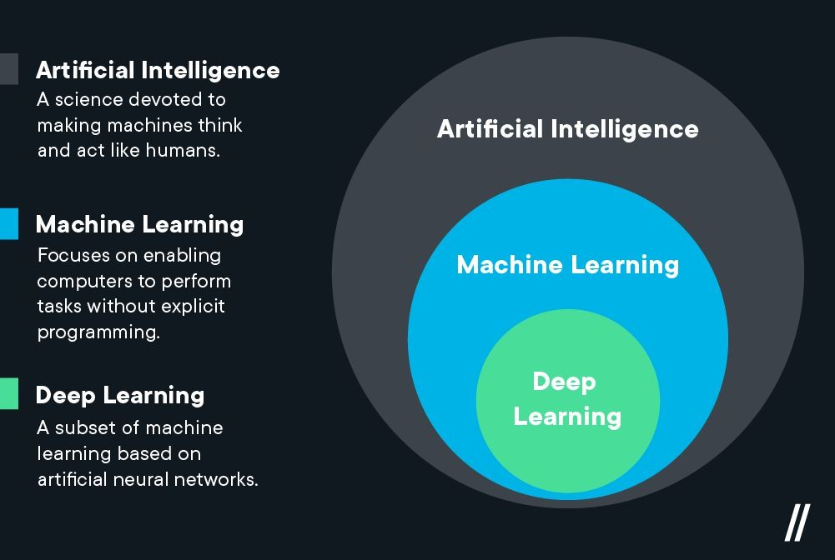

Slide 3
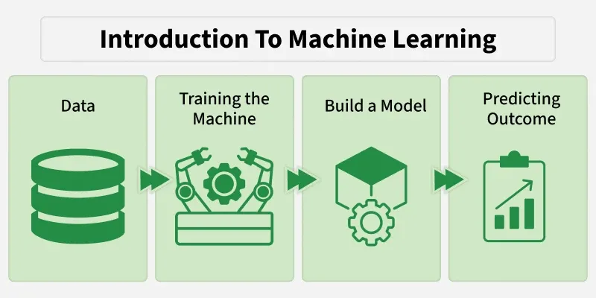
Machine learning is a branch of artificial intelligence which focuses on the use of data and algorithms to imitate the way that humans learn. It can detect patterns in data and use those patterns to make future predictions.

Slide 4
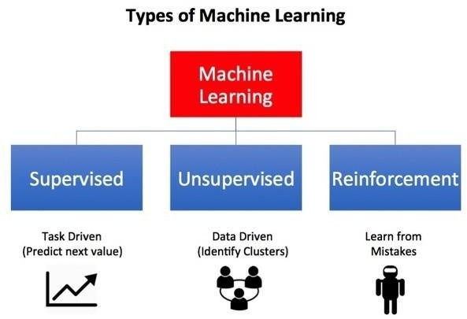
Broadly speaking, machine learning can be categorized into three main types:
Supervised Learning
Unsupervised Learning
Reinforcement Learning

Slide 5
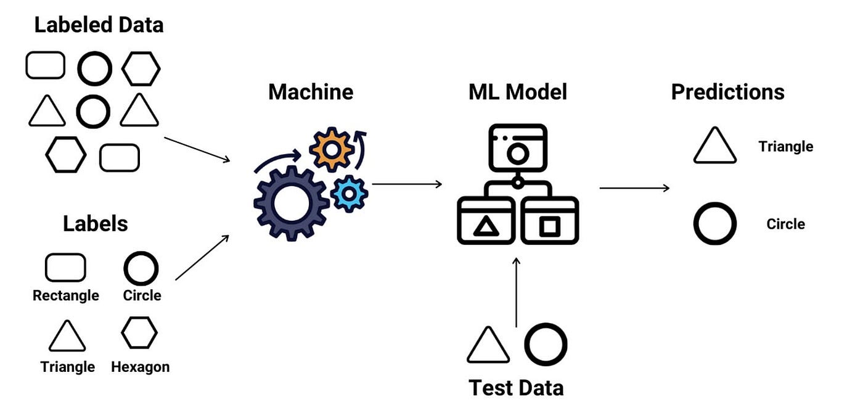
SUPERVISED LEARNING
Supervised Learning is the most popular approach for performing machine learning operations. It is widely used for data with a precise mapping between inputs and outputs.
The dataset, in this case, is labelled, meaning that the algorithm identifies the feature labels explicitly and carries out predictions or classification accordingly.

Slide 6

Supervised Learning algorithms
Linear Regression.
Random Forest.
Gradient Boosting.
Support Vector Machine.
Logistic Regression.
Supervised Learning Real life problems
Classifying documents into different document types automatically, as part of a document management workflow. The typical business benefits of ML-based document processing are the reduction of manual effort to save cost, faster processing time, and higher processing quality.
Assessing the sentiment of news articles to help understand the market perception of a brand or product or facilitate investment decisions.
Automating the objects or faces detection in images as part of a media image processing workflow. The business benefits this delivers are cost-saving from the reduction of human labor, faster processing, and higher accuracy.
Predicting the probability that someone will default on a bank loan. The business benefits this delivers are faster decision-making on loan application reviews and approvals, lower processing costs, and a reduced impact on a company's financial statement due to loan defaults.

Slide 7
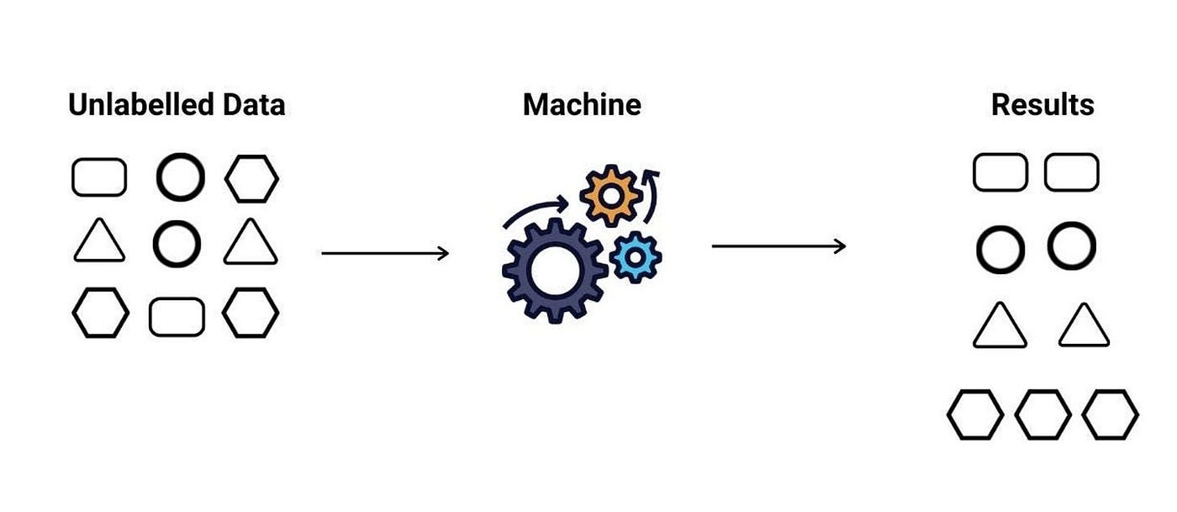
UNSUPERVISED LEARNING
Unsupervised learning is a form of machine learning in which the algorithm tries to detect/find patterns in data that do not have an outcome/target variable. In other words, we do not have data that comes with pre-existing labels. Thus, the algorithm will typically use a metric such as distance to group data together depending on how close they are to each other.
Some datasets do not come with a set of predefined labels and, as such, will only include input features without a target attribute.

Slide 8
Unsupervised learning Model Algorithms
K-means
The aim of the k-means clustering algorithm is to partition the n observations in the data into k clusters such that each observation belongs to the cluster with the nearest mean.
This serves as the prototype of the cluster.
DBSCAN
This is a clustering method that groups the data based on the density. It groups together the points that are given in the space and marks the outliers in the low-density region.
Hierarchical clustering
In this form of clustering, a hierarchy of clusters is built.
Examples of Unsupervised learning Problems
Customer segmentation for target marketing: By using customer attributes such as demographics and historical engagement data. The data-driven customer segmentation approach is usually more accurate than human judgment, which can be biased and subjective.
Computer network intrusion detection: By detecting outlier patterns that are different from normal network traffic patterns. Detecting anomalies in network traffic manually and rule-based processing is extremely challenging due to the high volume and changing dynamics of traffic patterns.
Reducing the dimensions of datasets: To visualize them in a 2D or 3D environment to help understand the data better and more easily.

Slide 9
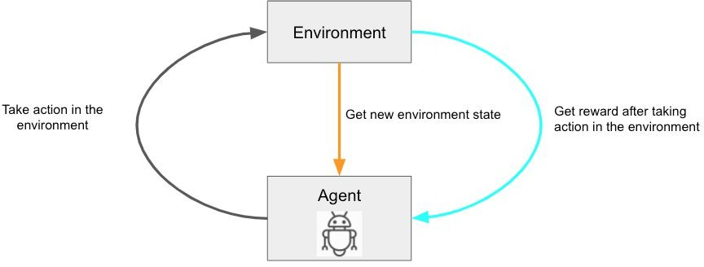
Reinforcement learning
Reinforcement learning is a type of ML where an ML model learns by trying out different actions and adjusts its future behaviors sequentially based on the received response from the action.
In reinforcement learning the agent learns from its own experience based on the rewards (positive or negative) it gets from is previous results.
Examples of Reinforcement learning problems
Robots or self-driving cars learn how to walk or navigate in unknown environments by trying out different moves and responding to the received results.
A recommendation engine optimizes product recommendations through adjustments based on the feedback of the customers to different product recommendations.
A truck delivery company optimizes the delivery route of its fleet to determine the delivery sequence required to achieve the best rewards, such as the lowest cost or shortest time.

Slide 10
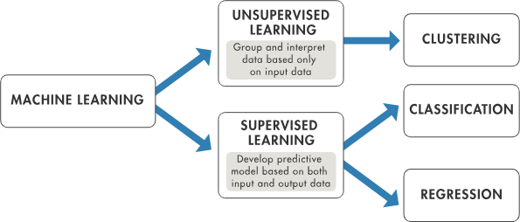

Slide 11
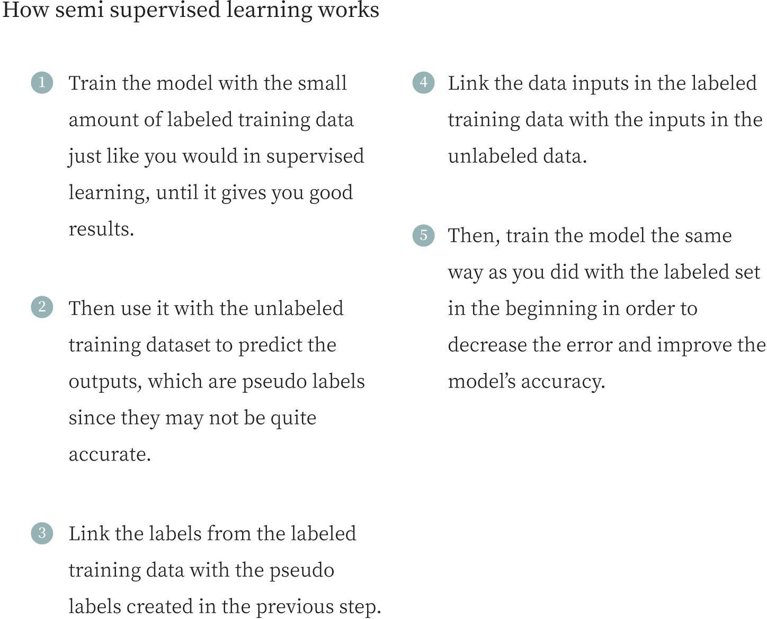
Semi-Supervised
Apart from the afore-mentioned 3 types of machine learning, there is also a hybrid machine learning system that combines both supervised and unsupervised machine learning. This form of machine learning is referred to as
Semi-supervised.

Slide 12
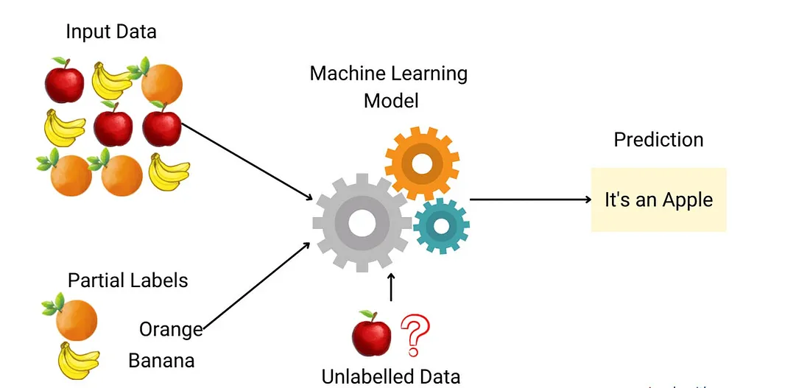
Semi-supervised learning is a machine learning approach that uses a small amount of labeled data together with a large amount of unlabeled data during training. It lies between supervised learning, which relies entirely on labeled data, and unsupervised learning, which uses no labeled data at all.

Slide 13
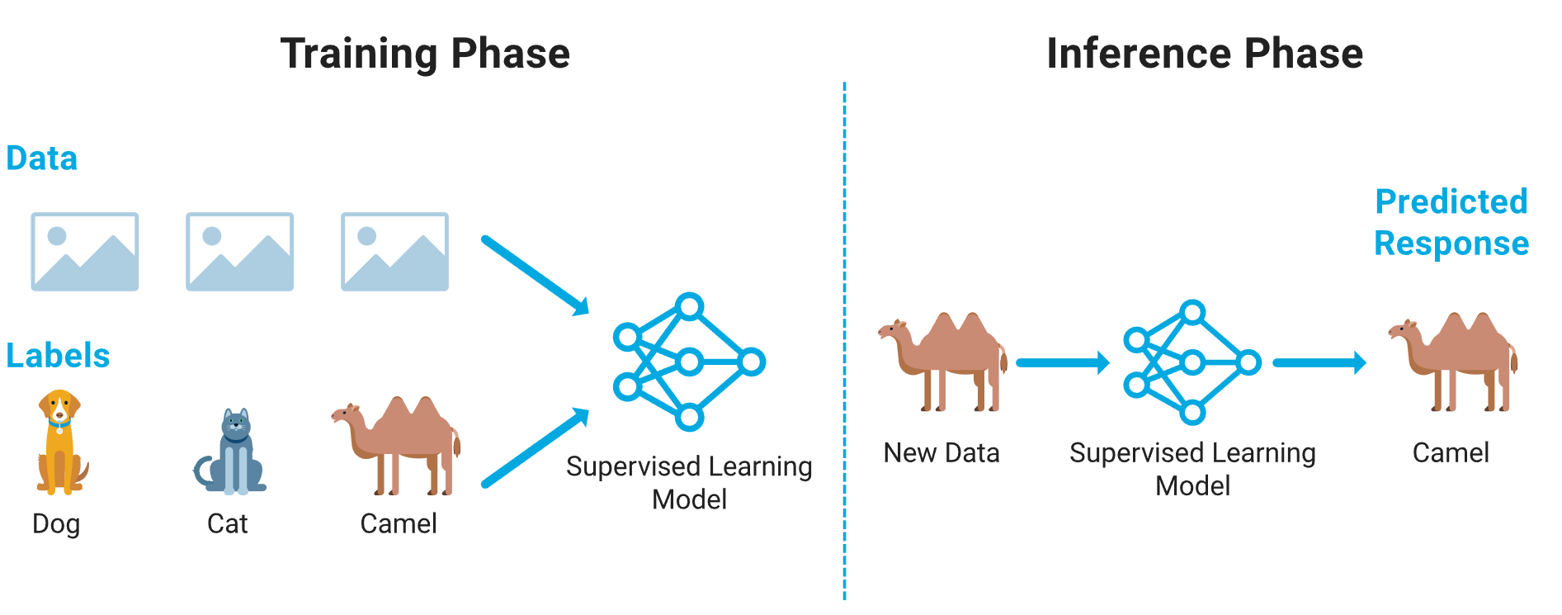
SUPERVISED LEARNING
There are 2 categories of supervised learning problems:
Classification
Classification is the process of learning a function that divides a dataset into distinct classes or labels based on specific features. In classification, a machine learning algorithm is trained using labeled training data, and it uses this learned pattern to assign new, unseen data into the appropriate classes or categories.
Classification problems
Creating a model which predicts whether a tumor is malignant or benign.
Creating a model that predicts whether an email is a spam or not.
A model that predicts whether an animal is a dog, camel or cat.

Slide 14
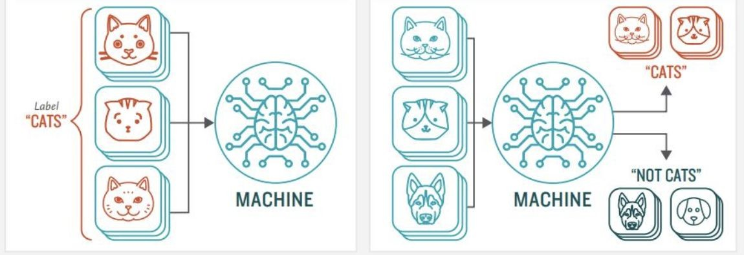
Classification Algorithms:
Logistic Regression
K-Nearest Neighbours
Support Vector Classification
Naïve Bayes
Decision Tree Classification
Random Forest Classification

Slide 15
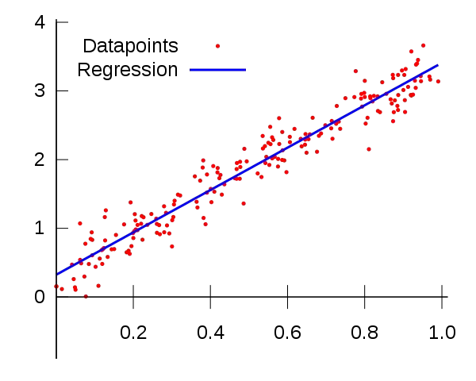
Regression:
Regression is a process used to identify the relationship between dependent and independent variables. It helps in predicting continuous values, such as house prices, salaries, and other numerical outcomes. The main task of a regression algorithm is to learn a mapping function that connects the input variable(s) (x) to a continuous output variable (y).
Examplє:
Suppose we want to do weather forecasting, so for this, we will use the Regression algorithm. In weather prediction, the model is trained on the past data, and once the training is completed, it can easily predict the weather for future days.
Suppose you want to predict the price of houses based on their square footage. You can train your model based on the sizes of different houses, with which it will be able to predict other properties.

Slide 16
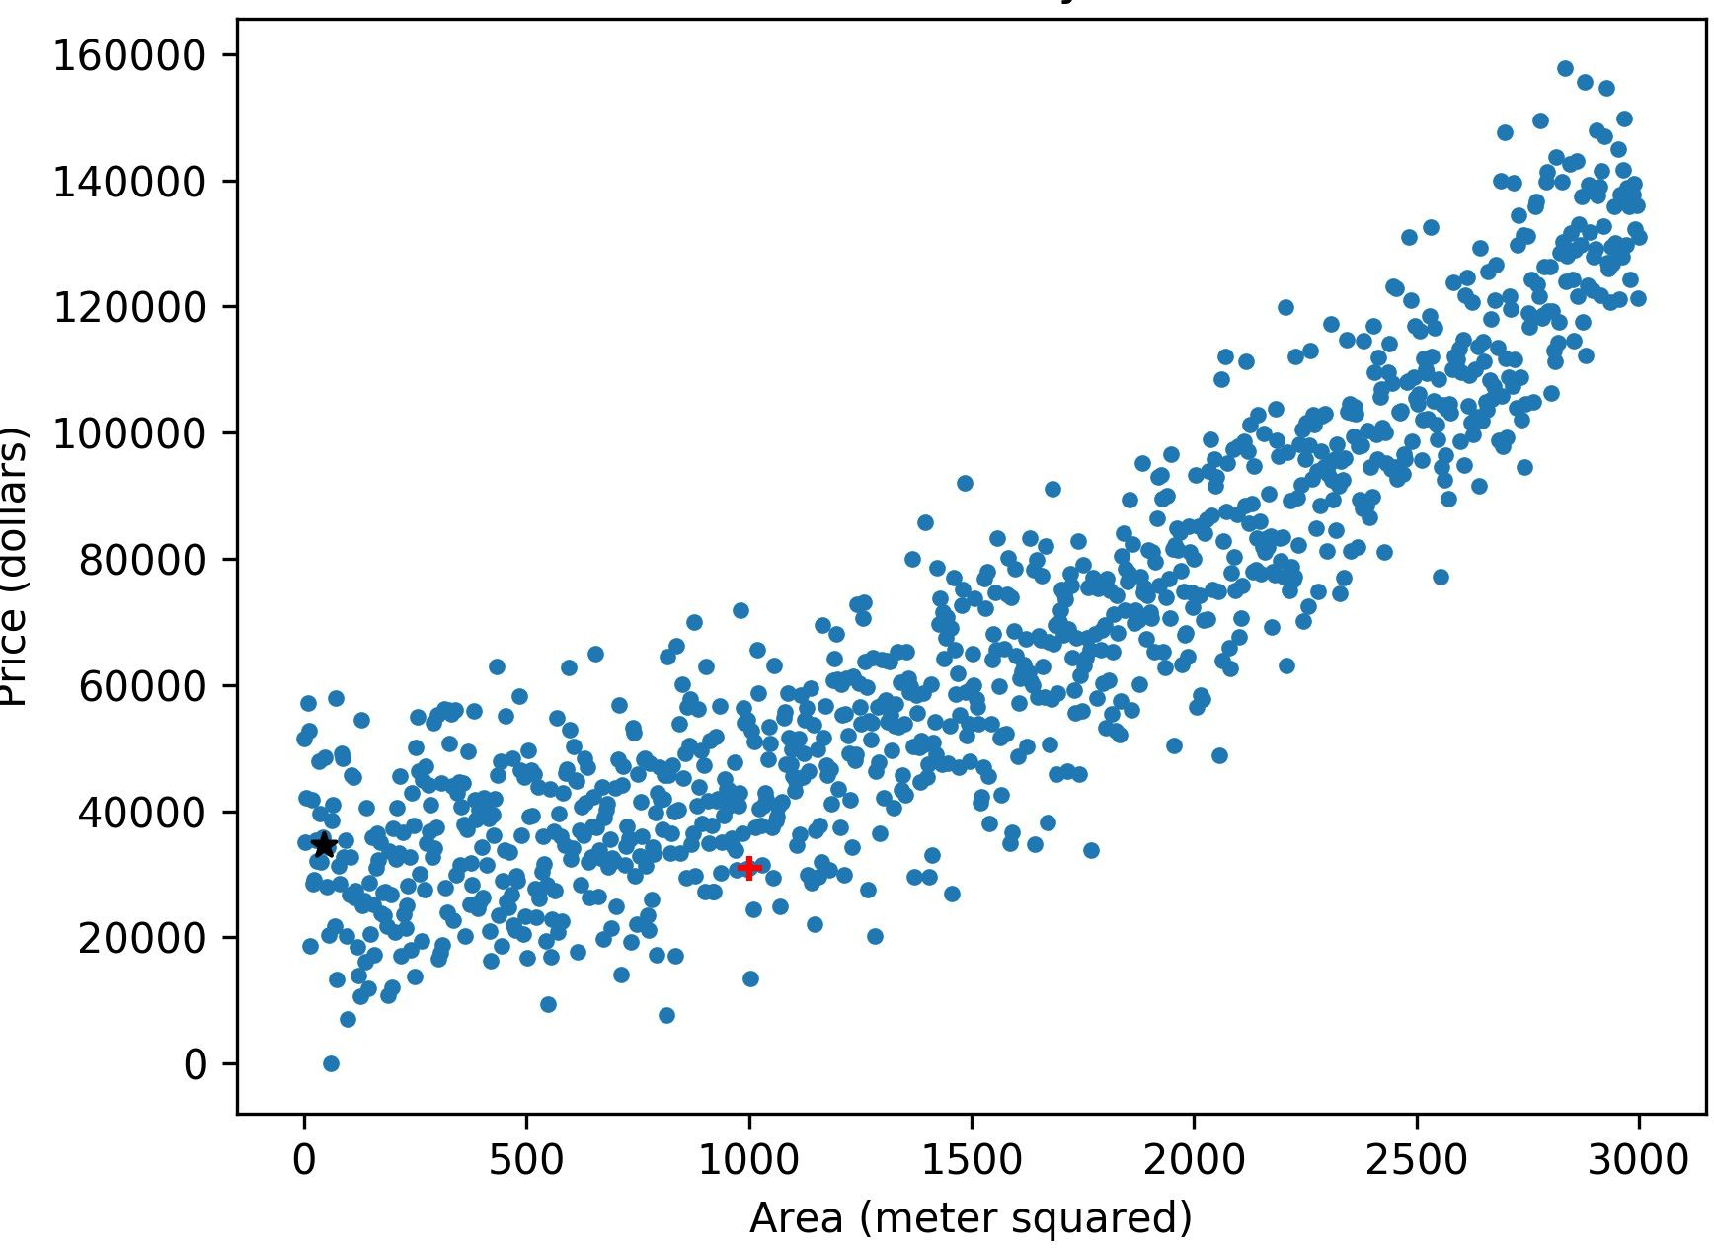
Regression Algorithms
Simple Linear Regression
Multiple Linear Regression
Polynomial Regression
Support Vector Regression
Decision Tree Regression
Random Forest Regression

Slide 17
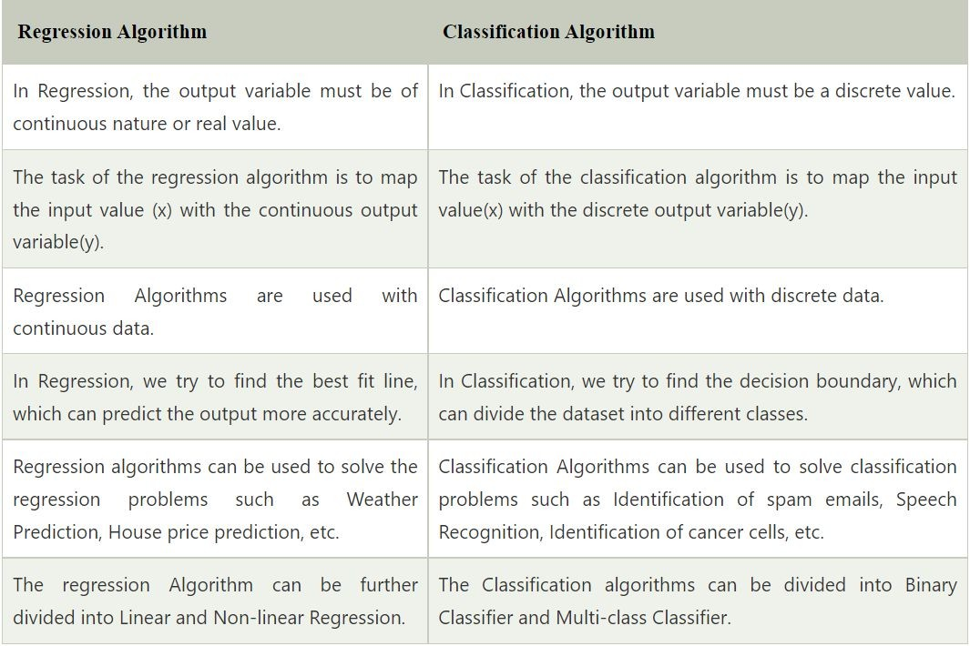

Slide 18
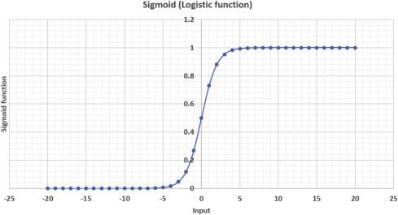
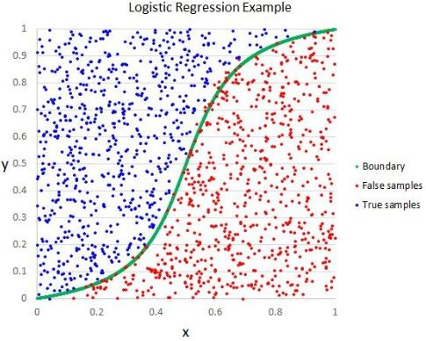
LOGISTIC REGRESSION
Logistic regression is a process of modeling the probability of a discrete outcome given an input variable. The most common logistic regression models a binary outcome; something that can take two values such as true/false, yes/no, and so on. Logistic regression, despite its name, is a classification model rather than regression model.
Logistic regression is a simple and more efficient method for binary and linear classification problems. Real-World Examples where logistic regression is used are Disease prediction (e.g., diabetes),Credit risk assessment, Purchase prediction and so on.

Slide 19
STRENGTH, WEAKNESS AND ASSUMPTION OF LOGISTICS REGRESSION
STRENGTH | WEAKNESS
Easy to interpret. | Assumes a linear relationship.
Efficient for small datasets. | Not ideal for complex or non-linear problems.
Probability-based predictions. | Requires independent features.
Handles binary outcomes well. | Struggles with imbalanced data.
Less prone to overfitting with regularization. | Sensitive to feature scaling.
ASSUMPTION OF LOGISTICS REGRESSION
Linearity: The relationship between input features and log-odds must be linear.
No Multicollinearity: Features should be independent of each other.
Large Sample Size: Logistic regression performs best with a larger sample size.
Binary Output: Works best when the output is binary.

Slide 20
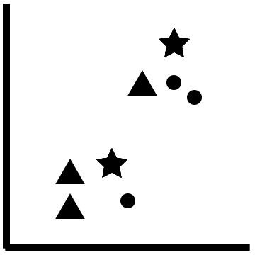
K-Nearest Neighbour
Popularly also know as KNN, is a supervised machine learning algorithm. The algorithm can be used to solve both classification and regression problem statements.
The number of nearest neighbours to a new unknown variable that has to be predicted or classified is denoted by the symbol ‘K’. The K-Nearest Neighbour aim is to locate all of the closest neighbours around a new unknown data point in order to figure out what class it belongs to. It’s a distance-based approach.
Real-World Examples where KNN is used are;
Recommendation Systems: Predicting user preferences based on similar users.
Image Recognition: Classifying images by comparing them with similar labeled images.
Customer Segmentation: Grouping customers based on purchasing behavior.
How k-NN works under the hood
The stars in the preceding diagram represent new data points. If we built a k-NN algorithm with three neighbors, then the stars would search for the three data points that are closest to it.
In the lower-left case, the star sees two triangles and one circle. Therefore, the algorithm would classify the star as a triangle since the number of triangles was greater than the number of circles.
In the upper-right case, the star sees two circles and one circle. Therefore, the algorithm will classify the star as a circle since the number of circles was greater than the number of triangles.

Slide 21
STRENGTH, WEAKNESS AND ASSUMPTION OF K-NEAREST NEIGHBOUR
STRENGTH | WEAKNESS
Simple and intuitive. | Computationally expensive for large datasets.
No assumptions about data distribution (non-parametric). | Sensitive to irrelevant or noisy features.
Can handle multi-class classification. | Requires a well-chosen value of 'k'.
Easily interpretable. | Performance degrades with high-dimensional data (curse of dimensionality).
ASSUMPTION OF K-NEAREST NEIGHBOUR
Proximity Assumption: Data points that are close to each other are likely to belong to the same class.
Stationarity: The distribution of the data doesn't change significantly over time.
Sufficient Data: Requires a representative sample for accuracy.
Choice of Distance Metric: The performance depends heavily on the choice of distance metric (e.g., Euclidean, Manhattan).

Slide 22
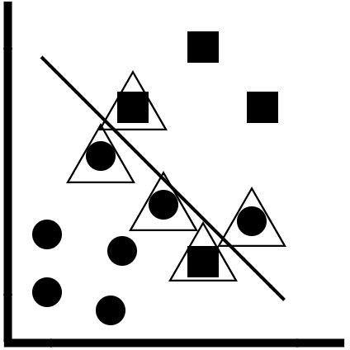
SUPPORT VECTOR MACHINES
Support Vector Machines are supervised learning models with associated learning algorithms that analyze data
for classification and regression analysis. The linear SVM classifier works by drawing a straight line between two classes. All the data points that fall on one side of the line will be labeled as one class and all the points that fall on the other side will be labeled as the second
The linear support vector machine is a form of linear classifier. A linear decision tree boundary is constructed, and the observations on one side of the boundary (the circles) belong to one class, while the observations on the other side of the boundary (the squares) belong to another class.
The support vectors are the observations that have a triangle on them.
These are the observations that are either very close to the linear decision boundary or have been incorrectly classified.
We can define which observations we want to make support vectors by defining how close to the decision boundary they should be.
This is controlled by the hyperparameter known as the inverse regularization strength.

Slide 23
STRENGTH, WEAKNESS AND ASSUMPTION OF SUPPORT VECTOR MACHINE
STRENGTH | WEAKNESS
Works well for both linear and non-linear classification using kernels. | Computationally expensive, especially for large datasets.
Robust against overfitting, especially in high-dimensional data. | Not effective when classes overlap significantly.
Useful in cases with a clear margin of separation between classes. | Hard to interpret compared to simpler models.
Versatile, with different kernel functions (e.g., linear, polynomial, RBF) for flexible decision boundaries. | Requires careful tuning of parameters (like C and kernel).
ASSUMPTION OF SVM
Margin Optimization: Assumes the data is separable, or nearly separable, with a clear margin.
Feature Scaling: Requires features to be scaled properly since SVMs are sensitive to the magnitude of the data.
Choice of Kernel: The performance heavily depends on the choice of the kernel function for non-linear data.
Balanced Classes: SVMs work best when the number of data points in each class is roughly balanced.

Slide 24
Real-World Examples where Support Vector Machine Algorithms is been Used
Image Classification: Used to classify images by identifying patterns and edges in high-dimensional pixel spaces.
Text Classification: Categorizing documents (spam vs. non-spam, sentiment analysis) based on feature vectors derived from text.
Bioinformatics: Classifying genes, proteins, and DNA sequences.
Face Detection: Identifying and classifying human faces in pictures.
Handwriting Recognition: Classifying handwritten characters into corresponding letters or numbers.

Slide 25
Classification And Regression with Trees
Tree based algorithms are very popular for two reasons: they are interpretable, and they make sound predictions that have won many machine learning competitions on online platforms, such as Kaggle. Furthermore, they have many use cases outside of machine learning for solving problems, both simple and complex.
Building a tree is an approach to decision-making used in almost all industries. Trees can be used to solve both classification- and regression-based problems, and have several use cases that make them the go-to solution!
We have both classification and regression trees
Classification Trees
Classification trees are used to predict a category or class. This is similar to the classification algorithms that you have learned about previously, such as the k-nearest neighbors algorithm or logistic regression. Broadly speaking, there are three tree based algorithms that are used to solve classification problems:
The decision tree classifier
The random forest classifier
The AdaBoost classifier

Slide 26
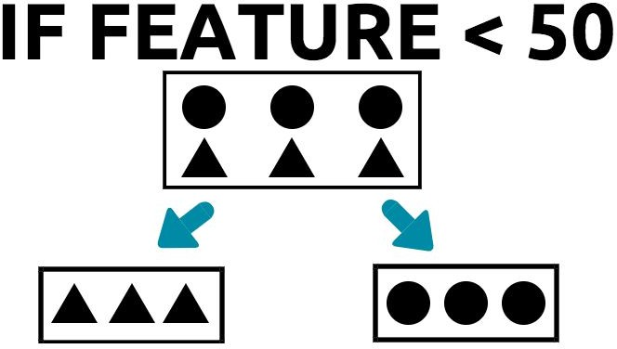
The Decision Tree Classifier
The decision tree is the simplest tree based algorithm, and serves as the foundation for the other two algorithms
A simple decision tree
A decision tree, in simple terms, is a set of rules that help us classify observations into distinct groups. In the previous diagram, the rule could be written as the following:
Let's consider the following simple decision tree
If (value of feature is less than 50); then (put the triangles in the left-hand box and put the circles in the right-hand box).
The boxes under the root node are known as the children. In the preceding tree,
the children are also the leaf nodes.
The leaf is the last set of boxes, usually in the bottommost part of the tree. As you might have guessed, the decision tree represents a regular tree, but inverted, or upside down.
The decision tree perfectly divides the observations into two distinct groups. This is a characteristic of the ideal decision tree. The first box on the top is called the root of the tree, and is the most important feature of the tree when it comes to deciding how to group the observations.

Slide 27
STRENGTH, WEAKNESS AND ASSUMPTION OF DECISION TREE CLASSIFIER
STRENGTH | WEAKNESS
Simple to understand and visualize. | Prone to overfitting, especially with deep trees.
Does not require feature scaling or normalization. | Sensitive to small variations in data, leading to different splits.
Handles both numerical and categorical data well. | May not perform well on imbalanced datasets.
Can capture non-linear relationships. | Less accurate compared to other algorithms like Random Forest or Gradient Boosting in some cases.
Assumption Of Decision Tree Classifier
Independence of Features: Assumes that features are independent and that splitting one feature does not influence others.
Sufficient Data for Learning: Requires enough data for meaningful decision-making and pattern recognition.
Non-linear Boundaries: Can model non-linear relationships between features and outputs, which is an inherent assumption of the model.

Slide 28
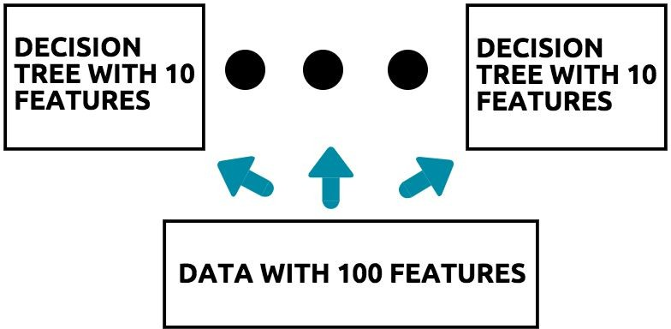
Random Forest Classifier
Random forests are a form of ensemble learning. An ensemble learning method is one that makes use of multiple machine learning models to make a decision.
Let's consider the following diagram:

Slide 29
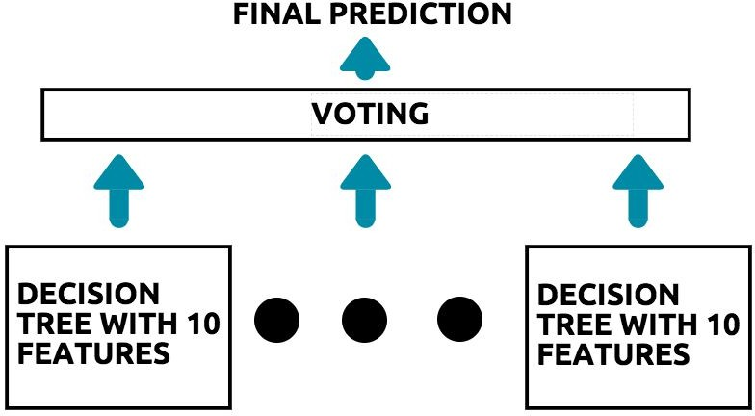
The concept of ensemble learning
The random forest algorithm operates as follows:
Assume that you initially have a dataset with 100 features.
From this, we will build a decision tree with 10 features initially. The features are selected randomly.
Now, using a random selection of the remaining 90 features, we construct the next decision tree, again with 10 features.
This process continues until there are no more features left to build a decision tree with.
At this point in time, we have 10 decision trees, each with 10 features.
Each decision tree is known as the base estimator of the random forest.
Thus, we have a forest of trees, each built using a random set of 10 features.
The next step for the algorithm is to make the prediction. In order to better understand how the random forest algorithm makes predictions, consider the following diagram:
The process of making predictions in random forests
Let's assume that there are 10 decision trees in the random forest.
Each decision tree makes a single prediction for the data that comes in.
If six trees predict class A, and four trees predict class B, then the final prediction of the random forest algorithm is class A, as it had the majority vote.
This process of voting on a prediction, based on the outputs of multiple models, is known as ensemble

Slide 30
STRENGTH, WEAKNESS AND ASSUMPTION OF RANDOM FOREST CLASSIFIER
STRENGTH | WEAKNESS
High accuracy than a single decision tree. | Slower compared to simpler models due to the large number of trees.
Resistant to overfitting especially when using a large number of trees. | More complex and harder to interpret compared to individual decision trees.
Can handle missing values and maintain accuracy. | Tends to perform poorly on highly imbalanced datasets without proper adjustments (e.g., class weighting).
Assumption Of Random Forest Classifier
Independent Decision Trees: Assumes that each decision tree is created independently from different random subsets of data.
Bagging: Random subsets of features and data points are used to reduce variance and improve generalization.
Sufficient Number of Trees: Requires a large number of trees to achieve good generalization and accuracy.
Diverse Features: Works best when features are diverse, reducing the risk of overfitting to any single feature.

Slide 31
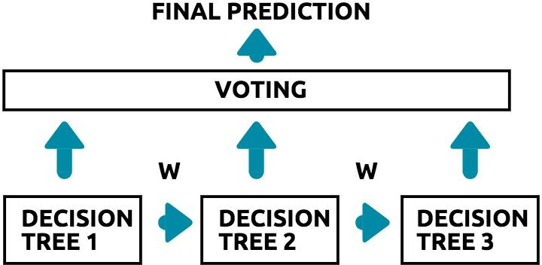
AdaBoost Classifier
AdaBoost stands for Adaptive Boosting, and is a boosting algorithm in which a lot of importance is given to the rows of data that the initial predictive model got wrong. This ensures that the next predictive model will not make the same mistakes. The process by which the AdaBoost algorithm works is illustrated in the following diagram:
An outline of the AdaBoost algorithm
In the preceding diagram of the AdaBoost algorithm, the following happens:
The first decision tree is built and outputs a set of predictions.
The predictions that the first decision tree 1 got wrong are given a weight of w and get passed to decision tree 2.
This enables decision tree 2 to learn at a faster rate, since we have more samples of the data in which an error was made beforehand.
This process is repeated until all the trees are built. Finally, the predictions of all the trees are gathered, and a weighted vote is initiated in order to determine the final prediction.

Slide 32
STRENGTH, WEAKNESS AND ASSUMPTION OF ADABOOST CLASSIFIER
STRENGTH | WEAKNESS
Converts weak models into strong models by boosting their performance. | Performance drops significantly if there is noisy data or outliers.
Often prevents overfitting by focusing on the hardest-to-classify examples. | Requires more computation as it builds multiple models iteratively.
It’s easy to understand and implement with weak classifiers like decision stumps (one-level decision trees). | Tends to overfit if the weak learners are too complex.
Assumption Of Adaboost Classifier
Weak Learners: Assumes that weak learners are slightly better than random guessing (accuracy slightly above 50%).
Additive Model: Assumes the combination of weak learners leads to a strong overall model.
Iterative Process: Boosting assumes that focusing on misclassified examples will improve performance over multiple iterations.
Feature Independence: Like many algorithms, it assumes that features are independent (though AdaBoost can still work well with correlated features).

Slide 33
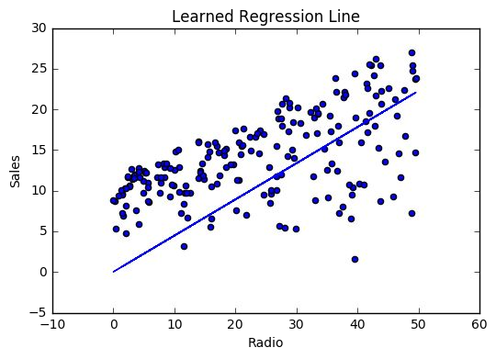
LINEAR REGRESSION
Linear Regression is a supervised machine learning algorithm where the predicted output is continuous and has a constant slope. It’s used to predict values within a continuous range, (e.g. sales, price) rather than trying to classify them into categories (e.g. cat, dog). There are basically 2 types of linear regression:
Simple linear regression: uses traditional slope-intercept form, where W and b are the variables our algorithm will try to “learn” to produce the most accurate predictions. x represents our input data and y represents our prediction.
Multivariable regression: A more multi-variable linear equation has more than one independent variable and might look like this, where w represents the coefficients, or weights, our model will try to learn.
y=Wx+b
y=W1x1+W2x2+W3x3+b

Slide 34
STRENGTH, WEAKNESS AND ASSUMPTION OF LINEAR REGRESSION
STRENGTH | WEAKNESS
Easy to understand and implement. | Limited to linear relationships
Quick to train, especially with small to medium-sized datasets. | Sensitive to outliers: Outliers can significantly skew results.
Provides clear insight into feature relationships through coefficients. | Assumes independence: Poor performance if features are highly correlated (multicollinearity).
Performs well for data with linear trends. | Prone to overfitting with too many features: Complex models with many features can overfit.
Assumption Of Linear Regression
Linearity: Assumes a linear relationship between dependent and independent variables.
Independence: Observations are assumed to be independent of each other.
Homoscedasticity: Variability in residuals should be constant across all levels of the independent variables.

Slide 35


Naïve Bayes Algorithm
The Naive Bayes algorithm makes use of the Bayes theorem, in order to classify classes and categories. The word naive was given to the algorithm because the algorithm assumes that all attributes are independent of one another. This is not actually possible, as every attribute/feature in a dataset is related to another attribute, in one way or another.
Despite being naive, the algorithm does well in actual practice. The formula for the Bayes theorem is as follows: Bayes theorem formula:
p(h|D): This is the probability of a hypothesis taking place, provided that we have a dataset. An example of this would be the probability of a fraudulent transaction taking place, provided that we had a dataset that consisted of fraudulent and non-fraudulent transactions.
p(D|h): This is the probability of having the data, given a hypothesis. An example of this would be the probability of having a dataset that contained fraudulent transactions.
p(h): This is the probability of a hypothesis taking place, in general. An example of this would be a statement that the average probability of fraudulent transactions taking place in the mobile industry is 2%.
p(D): This is the probability of having the data before knowing any hypothesis. An example of this would be the probability that a dataset of mobile transactions could be found without knowing what we wanted to do with it (for example, predict fraudulent mobile transactions). The above formula can then be rewritten as :

Slide 36
STRENGTH, WEAKNESS AND ASSUMPTION OF NAIVES BAYES ALGORITHMS
STRENGTH | WEAKNESS
Fast and efficient: Quick to train, even on large datasets. | Strong independence assumption: Assumes all features are independent, which is rarely true in real-life data.
Handles categorical data well: Suitable for both binary and multi-class classification tasks. | Sensitive to zero probabilities: A single instance of a zero probability feature can make the entire probability zero (can be mitigated with techniques like Laplace smoothing).
Requires less data: Performs well with smaller datasets compared to other algorithms. | Not suitable for complex relationships: Struggles with highly interdependent features or non-linear relationships.
Assumption Of Naives Bayes Algorithms
Conditional Independence: Assumes all features are independent of each other, given the class label.
Feature Relevance: Assumes that all features contribute equally to the outcome, which is crucial for correct classification.
Data Balance: Assumes that the classes in the dataset are not extremely imbalanced.

Slide 37
STRENGTH, WEAKNESS AND ASSUMPTION OF NAIVES BAYES ALGORITHMS
STRENGTH | WEAKNESS
Fast and efficient: Quick to train, even on large datasets. | Strong independence assumption: Assumes all features are independent, which is rarely true in real-life data.
Handles categorical data well: Suitable for both binary and multi-class classification tasks. | Sensitive to zero probabilities: A single instance of a zero probability feature can make the entire probability zero (can be mitigated with techniques like Laplace smoothing).
Requires less data: Performs well with smaller datasets compared to other algorithms. | Not suitable for complex relationships: Struggles with highly interdependent features or non-linear relationships.
Assumption Of Naives Bayes Algorithms
Conditional Independence: Assumes all features are independent of each other, given the class label.
Feature Relevance: Assumes that all features contribute equally to the outcome, which is crucial for correct classification.
Data Balance: Assumes that the classes in the dataset are not extremely imbalanced.

Slide 38
Regression Trees
Previously we saw how trees are used in order to classify a prediction as belonging to a particular class or category. However, trees can also be used to solve problems related to predicting numeric outcomes.
Some Tree algorithms for predicting numeric outcomes include:
The decision tree regressor
The random forest regressor
The gradient boosted tree
The Decision Tree Regressor
When we have data that is non-linear in nature, a linear regression model might not be the best model to choose. In such situations, it makes sense to choose a model that can fully capture the non-linearity of such data. A decision tree regressor can be used to predict numeric outcomes, just like that of the linear regression model.

Slide 39
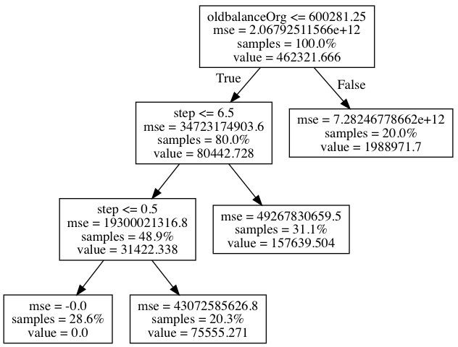
Consider the tree shown in the following diagram:
We are trying to predict the amount of a mobile transaction using the tree.
When the tree tries to decide on a split, it chooses the node in such a way that the target value is closest to the mean values of the target in that node.
You will notice that, as you go down the tree to the left, along the True cases, the mean squared error of the nodes decreases.
Therefore, the nodes are built in a recursive fashion, such that it reduces the overall mean squared error, thereby obtaining the True value.
In the preceding tree, if the old balance of origination is less than 600,281, then the amount (here, coded as value) is 80,442, and if it's greater than 600,281, then the amount is 1,988,971.

Slide 40
The Random Forest Regressor
The random forest regressor takes the decision tree regressor as the base estimator, and makes predictions in a method similar to that of the random forest classifier, as illustrated by the following diagram:
The only difference between the random forest classifier and the random forest regressor is the fact that, in the case of the latter, the base estimator is a decision tree regressor.

Slide 41
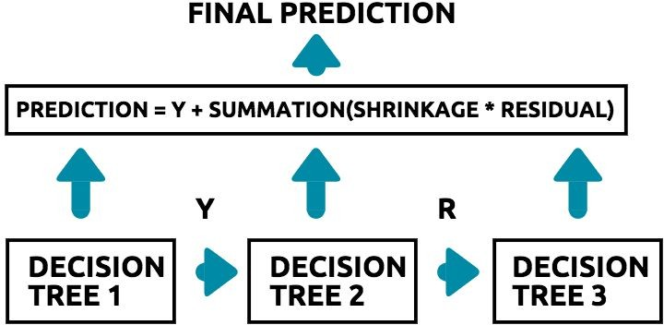
The Gradient Boosted Tree
In the AdaBoost classifier, weights are added to the examples that the classifier predicted in correctly. In the gradient boosted tree, however, instead of weights, the residual errors are used as labels in each tree in order to make future predictions. This concept is illustrated for you in the following diagram:
Here is what occurs in the diagram:
The first decision tree is trained with the data that you have, and the target variable Y.
We then compute the residual error for this tree.
The residual error is given by the difference between 7.The shrinkage is a factor with which we control the rate
the predicted value and the actual value.
at which we want this gradient boosting process to take place.
4.The second tree is now trained, using the residuals
as the target.
8.A small value of shrinkage (learning rate) implies that the algorithm will learn more quickly, and therefore, must be compensated with a larger number of base estimators (that is, decision trees) in order to prevent overfitting.
9.A larger value of shrinkage (learning rate) implies that the algorithm will learn more slowly, and thus requires fewer trees in order to reduce the computational time.
5.This process of building multiple trees is iterative,
and continues for the number of base estimators that we have.
6.The final prediction is made by adding the target
value predicted by the first tree to the product of the shrinkage and the residuals for all the other trees.

Slide 42
STRENGTH, WEAKNESS AND ASSUMPTION OF GRADIENT BOOSTED TREE
STRENGTH | WEAKNESS
High accuracy: Often achieves high performance, especially in competitions. | Computationally intensive: Requires significant processing power and time, especially with large datasets.
Handles complex relationships: Effective with non-linear relationships. | Sensitive to overfitting: Can overfit easily, particularly on noisy data, if not properly regularized.
Customizable: Can fine-tune parameters to achieve optimal performance. | Hyperparameter tuning complexity: Needs careful tuning of parameters like learning rate, depth, and number of trees.
Feature Importance: Provides feature importance scores, helping with feature selection. | Imbalanced data challenge: May perform poorly on highly imbalanced datasets without adjustments.
Assumption Of Gradient Boosted Tree
Additive Model: Assumes that combining weak learners will progressively correct errors.
Data Distribution: Assumes that errors in predictions decrease as each tree corrects its predecessor.
Feature Independence: Works better if features aren’t highly correlated, though it can handle some level of multicollinearity.

Slide 43
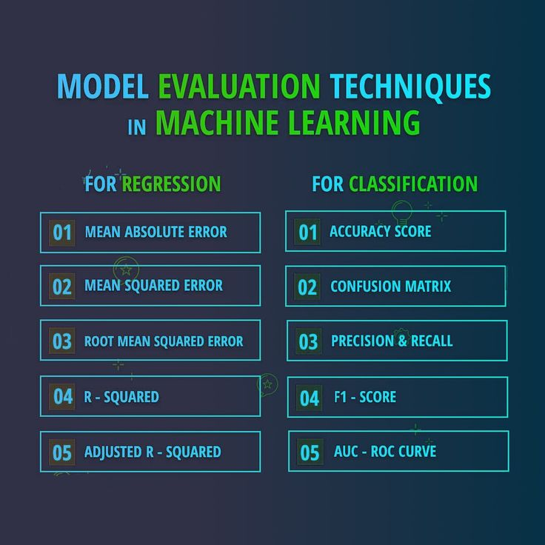
Definition of Model Evaluation
Model evaluation refers to the systematic assessment of a machine learning model's performance against predefined criteria or metrics. It is a critical step in the model development lifecycle, aimed at gauging how well the model generalizes to new, unseen data. Model evaluation involves the use of various metrics and techniques to measure the model's predictive accuracy, reliability, and generalization capabilities.

Slide 44
Purpose of Model Evaluation
The primary purposes of model evaluation extend beyond the mere assessment of model accuracy. Key objectives include:
1. Improving Generalization: Model evaluation helps ensure that the trained model can generalize well to new, unseen data. Generalization is crucial for a model's success in real-world scenarios and different datasets.
2. Avoiding Overfitting: Overfitting occurs when a model performs exceptionally well on the training data but fails to generalize to new data. Model evaluation serves as a tool to identify and mitigate overfitting by assessing how well the model performs on unseen data.
3. Ensuring Model Reliability: Reliable models consistently provide accurate predictions across various datasets and conditions. Model evaluation helps assess the reliability of a model in different scenarios, ensuring its robustness in practical applications.

Slide 45
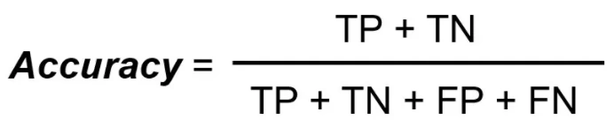
Model Evaluation for Classification
There are many ways for measuring classification performance. Accuracy, confusion matrix, and AUC-ROC are some of the most popular metrics. Precision-recall is a widely used metrics for classification problems.
Accuracy simply measures how often the classifier correctly predicts. We can define accuracy as the ratio of the number of correct predictions and the total number of predictions. When any model gives an accuracy rate of 99%, you might think that model is performing very good but this is not always true and can be misleading in some situations. Accuracy is useful when the target class is well balanced but is not a good choice for the unbalanced classes.

Slide 46
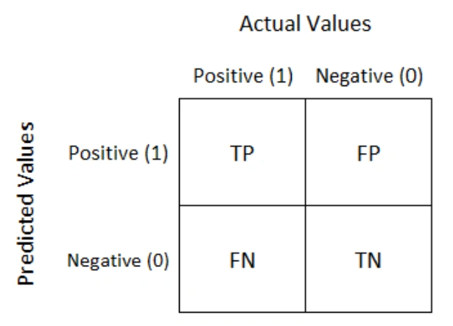
Confusion Matrix is a performance measurement for the machine learning classification problems where the output can be two or more classes. It is a table with combinations of predicted and actual values.
A confusion matrix is defined as thetable that is often used to describe the performance of a classification model on a set of the test data for which the true values are known.
It is extremely useful for measuring the Recall, Precision, Accuracy, and AUC-ROC curves. Let’s try to understand TP, FP, FN, TN with an example of pregnancy analogy.

Slide 47
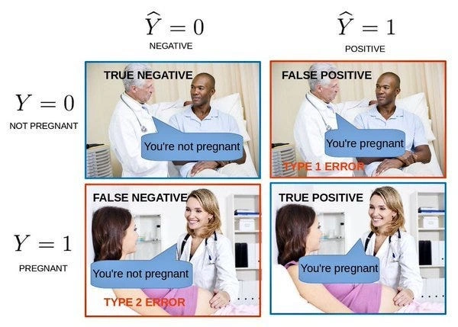
True Positive: We predicted positive and it’s true. In the image, we predicted that a woman is pregnant and she actually is.
True Negative: We predicted negative and it’s true. In the image, we predicted that a man is not pregnant and he actually is not.
False Positive (Type 1 Error): We predicted positive and it’s false. In the image, we predicted that a man is pregnant but he actually is not.
False Negative (Type 2 Error): We predicted negative and it’s false. In the image, we predicted that a woman is not pregnant but she actually is.

Slide 48
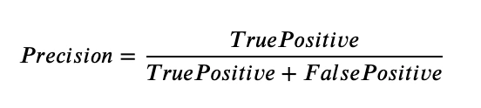
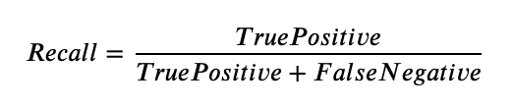
Precision
It explains how many of the correctly predicted cases actually turned out to be positive. Precision is useful in the cases where False Positive is a higher concern than False Negatives. Precision for a label is defined as the number of true positives divided by the number of predicted positives.
Recall (Sensitivity)
It explains how many of the actual positive cases we were able to predict correctly with our model. Recall is a useful metric in cases where False Negative is of higher concern than False Positive. Recall for a label is defined as the number of true positives divided by the total number of actual positives.

Slide 49
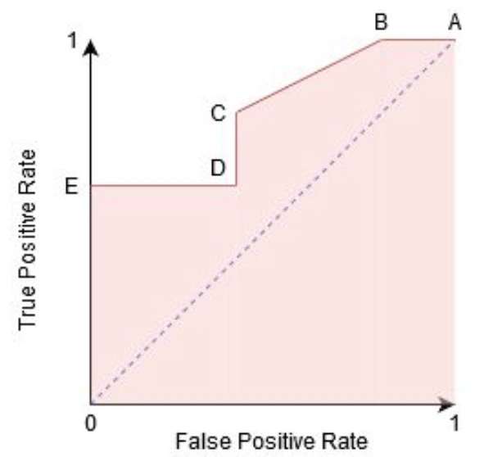
F1 Score
It gives a combined idea about Precision and Recall metrics. It is maximum when Precision is equal to Recall. The F1 score punishes extreme values more. F1 Score could be an effective evaluation metric in the following cases:
When FP and FN are equally costly.
Adding more data doesn’t effectively change the outcome
True Negative is high
AUC-ROC
The Receiver Operator Characteristic (ROC) is a probability curve that plots the TPR(True Positive Rate) against the FPR(False Positive Rate) at various threshold values and separates the ‘signal’ from the ‘noise’.
The Area Under the Curve (AUC) is the measure of the ability of a classifier to distinguish between classes. From the graph, we simply say the area of the curve ABDE and the X and Y-axis.
Working of AUC
In a ROC curve, the X-axis value shows False Positive Rate (FPR), and Y-axis shows True Positive Rate (TPR). Higher the value of X means higher the number of False Positives(FP) than True Negatives(TN), while a higher Y-axis value indicates a higher number of TP than FN. So, the choice of the threshold depends on the ability to balance between FP and FN.

Slide 50
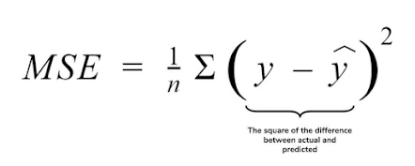
Model Evaluation for Regression
There are many ways for measuring regression performance.Mean Absolute Error(MAE), Mean Squared Error(MSE), Root Mean Squared Error(RMSE), Root Mean Squared Log Error(RMSLE), R Squared (R2), R Squared (R2).
Mean Squared Error(MSE)
MSE is a most used and very simple metric with a little bit of change in mean absolute error. It represents the squared distance between actual and predicted values. we perform squared to avoid the cancellation of negative terms and it is the benefit of MSE.

Slide 51
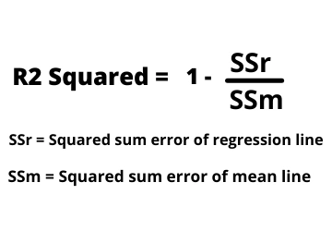
R Squared (R2)
R2 score is a metric that tells the performance of your model, not the loss in an absolute sense that how many wells did your model perform. It represents the proportion of variance in the dependent variable explained by the model and ranges from 0 to 1; higher values indicate better model fit.
R2 squared is also known as Coefficient of Determination or sometimes also known as Goodness of fit.

Slide 52
THE END
THANK YOU

